Slide 1
PROGRAMMING STUDIO FOOD WASTE HELP.org
<p> Noah Bakr s4095646 Connor Orders s4096467 </p>
Notes:
NOAH
Introduce product

Slide 2
THE PERSONAS
Notes:
NOAH OR CONNOR
Present Personas to the audience
John Smith
Smith Produce owner, can’t see well, passionate about food waste
Lucia Romano
Works for greengrocer, marketing and research, needs data for a job
Karen Williams
At home mum, is at consumer level, seeks info to help waste in household

Slide 3


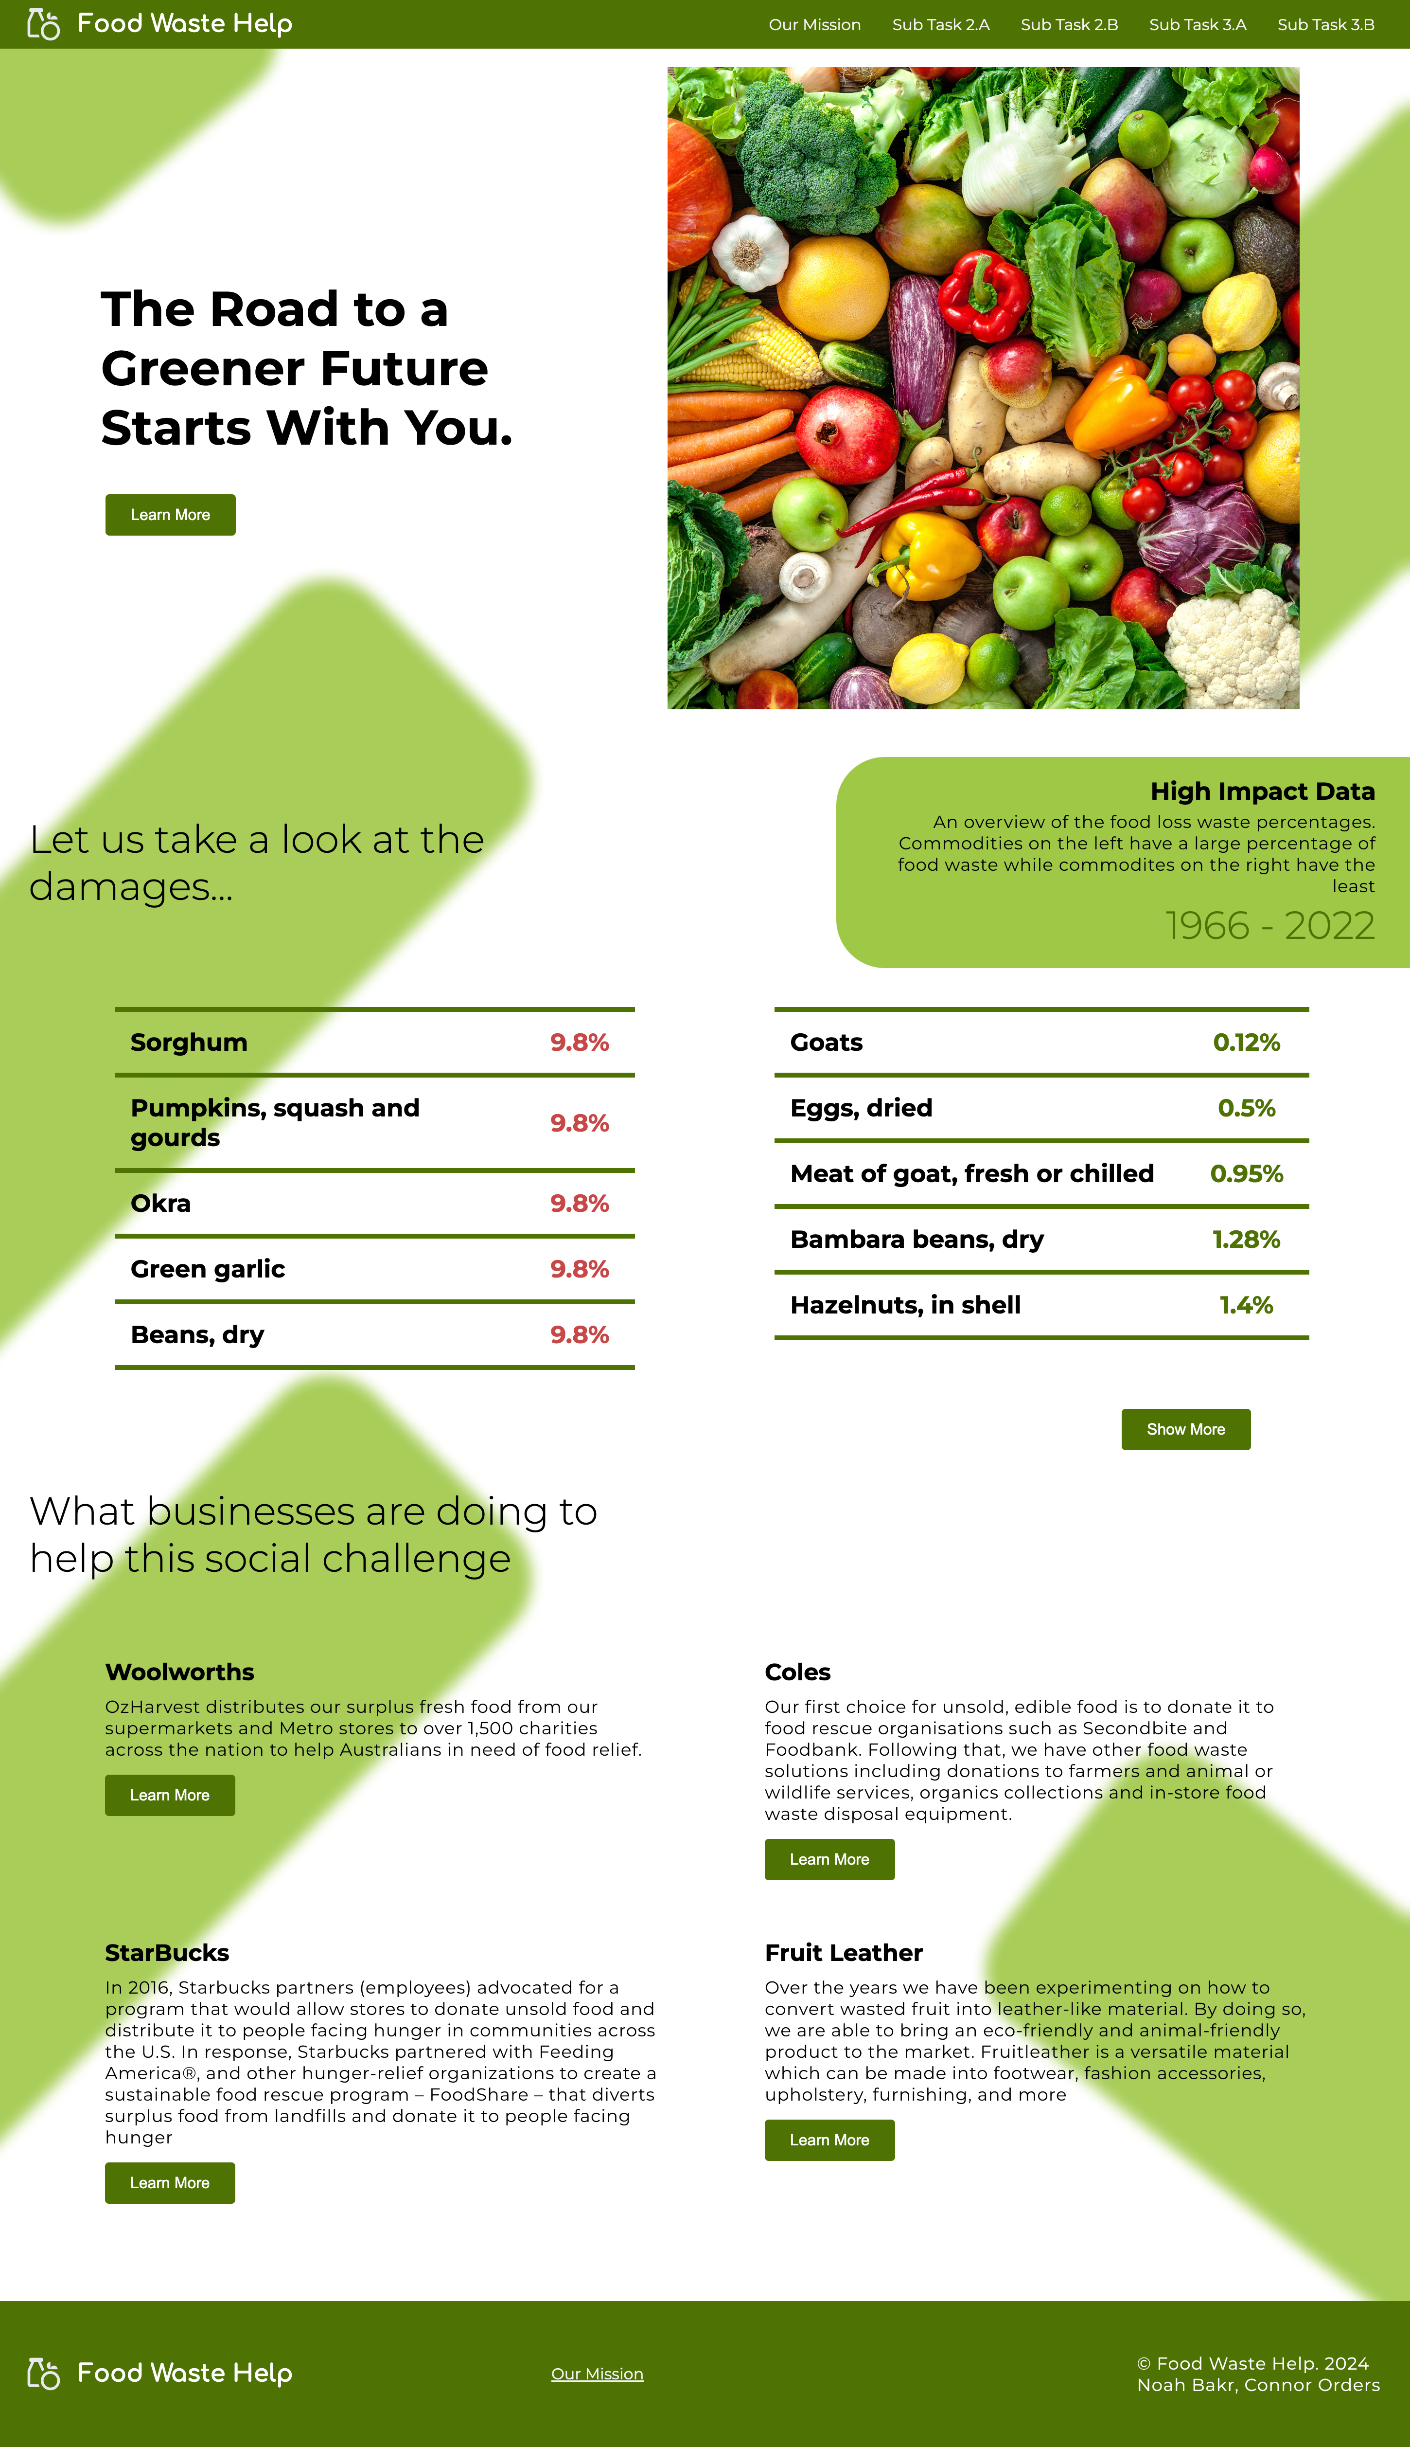
THE LANDING
PAGE
A clean, warm welcome section that invites the user while simultaneously presents topics of fresh fruit and vegetables
Notes:
NOAH
Purpose behind this section
Large text for readability (John Smith)
Design Patterns
The immediate action button
Navigation Tabs
Home link/escape hatch (navigation)

Slide 4
AESTHETIC AND MINIMALISTIC
DESIGN HEURISTIC
Clean UI/UX that does not overwhelm the user
An Attractive UI
Notes:
NOAH
Visual design focused on the essentials
Time efficient
Attractive and Clean

Slide 5
THE LANDING
PAGE
A table outlining the top 5 highest food contributors towards food waste and the 5 least, providing an overall picture to the user
Notes:
NOAH
Purpose behind this section
Accessible snapshot of data (Karen Williams)
Design Patterns
Middle Aligned tables

Slide 6
MATCH BETWEEN SYSTEM AND REAL WORLD
DESIGN HEURISTIC
Red is bad while Green is good
Traffic light approach
Users automatically assume this rule
Notes:
NOAH
Very quickly understand the table
Users process colours quicker than numbers
Less cognitive effort

Slide 7
THE LANDING
PAGE
Business information panel allows for the users to view a snapshot of how businesses are helping to prevent food waste
Notes:
NOAH
Purpose behind this section
John Smith & Karen Williams can view businesses
Informs them of the active businesses and where to go for more information
Design Patterns
Buttons takes them to the websites

Slide 8
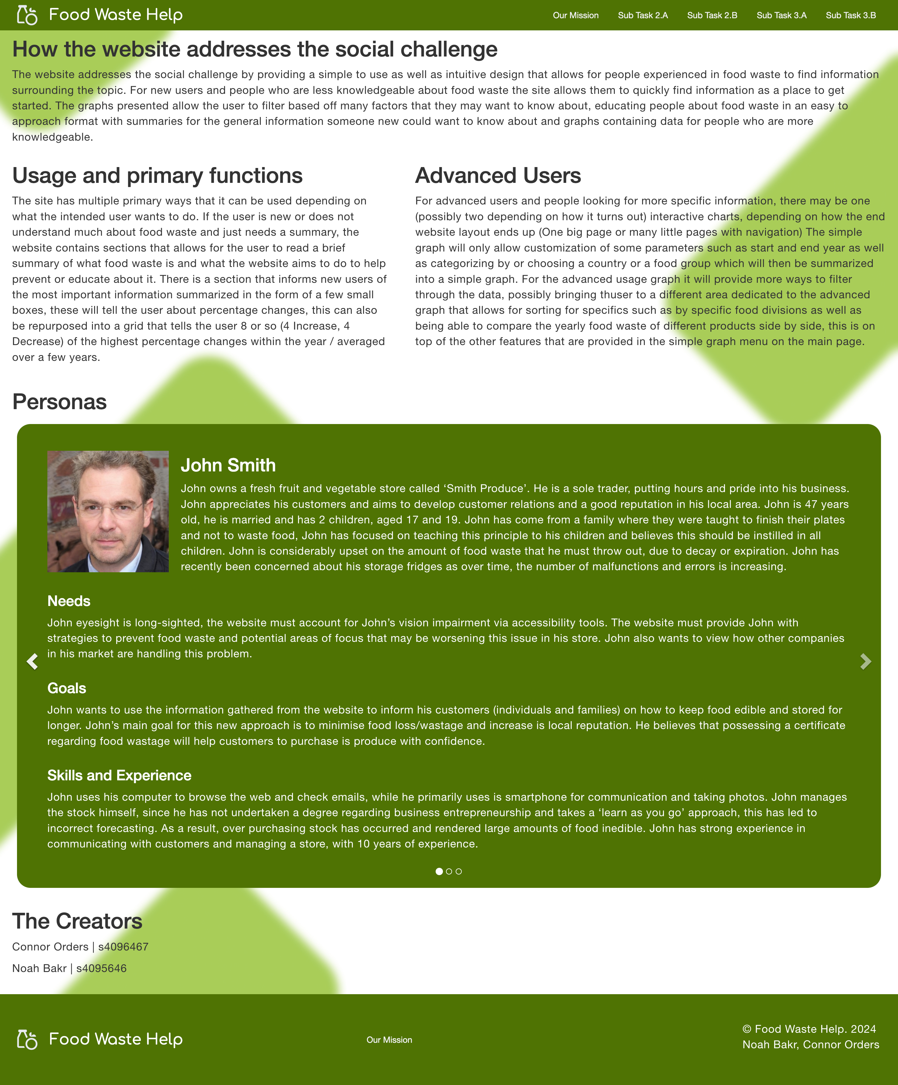
THE MISSION
PAGE
Provides context to the user regarding our purpose, how to use our website and the extent of our advanced tools/processes
Notes:
CONNOR
Purpose behind this section
Context and info on how to use the website
Design Patterns
Left Aligned Text

Slide 9
THE MISSION
PAGE
A carousel display that presents the 3 personas utilised in the planning & development of the website
Notes:
CONNOR
This section is for assessors
Design Patterns
Carousel
Arrow buttons
Indicator presenting which persona is active and how many there are

Slide 10
FLEXIBILITY AND EFFICIENCY OF USE
DESIGN HEURISTIC
The carousel can be interacted with in multiple ways
Clicking the arrow or the three dots
Using the keyboard with arrow keys
Notes:
CONNOR
Arrow keys can be used
Two different levels of interaction
Mouse and shortcuts
Keep going right and cycle will repeat

Slide 11
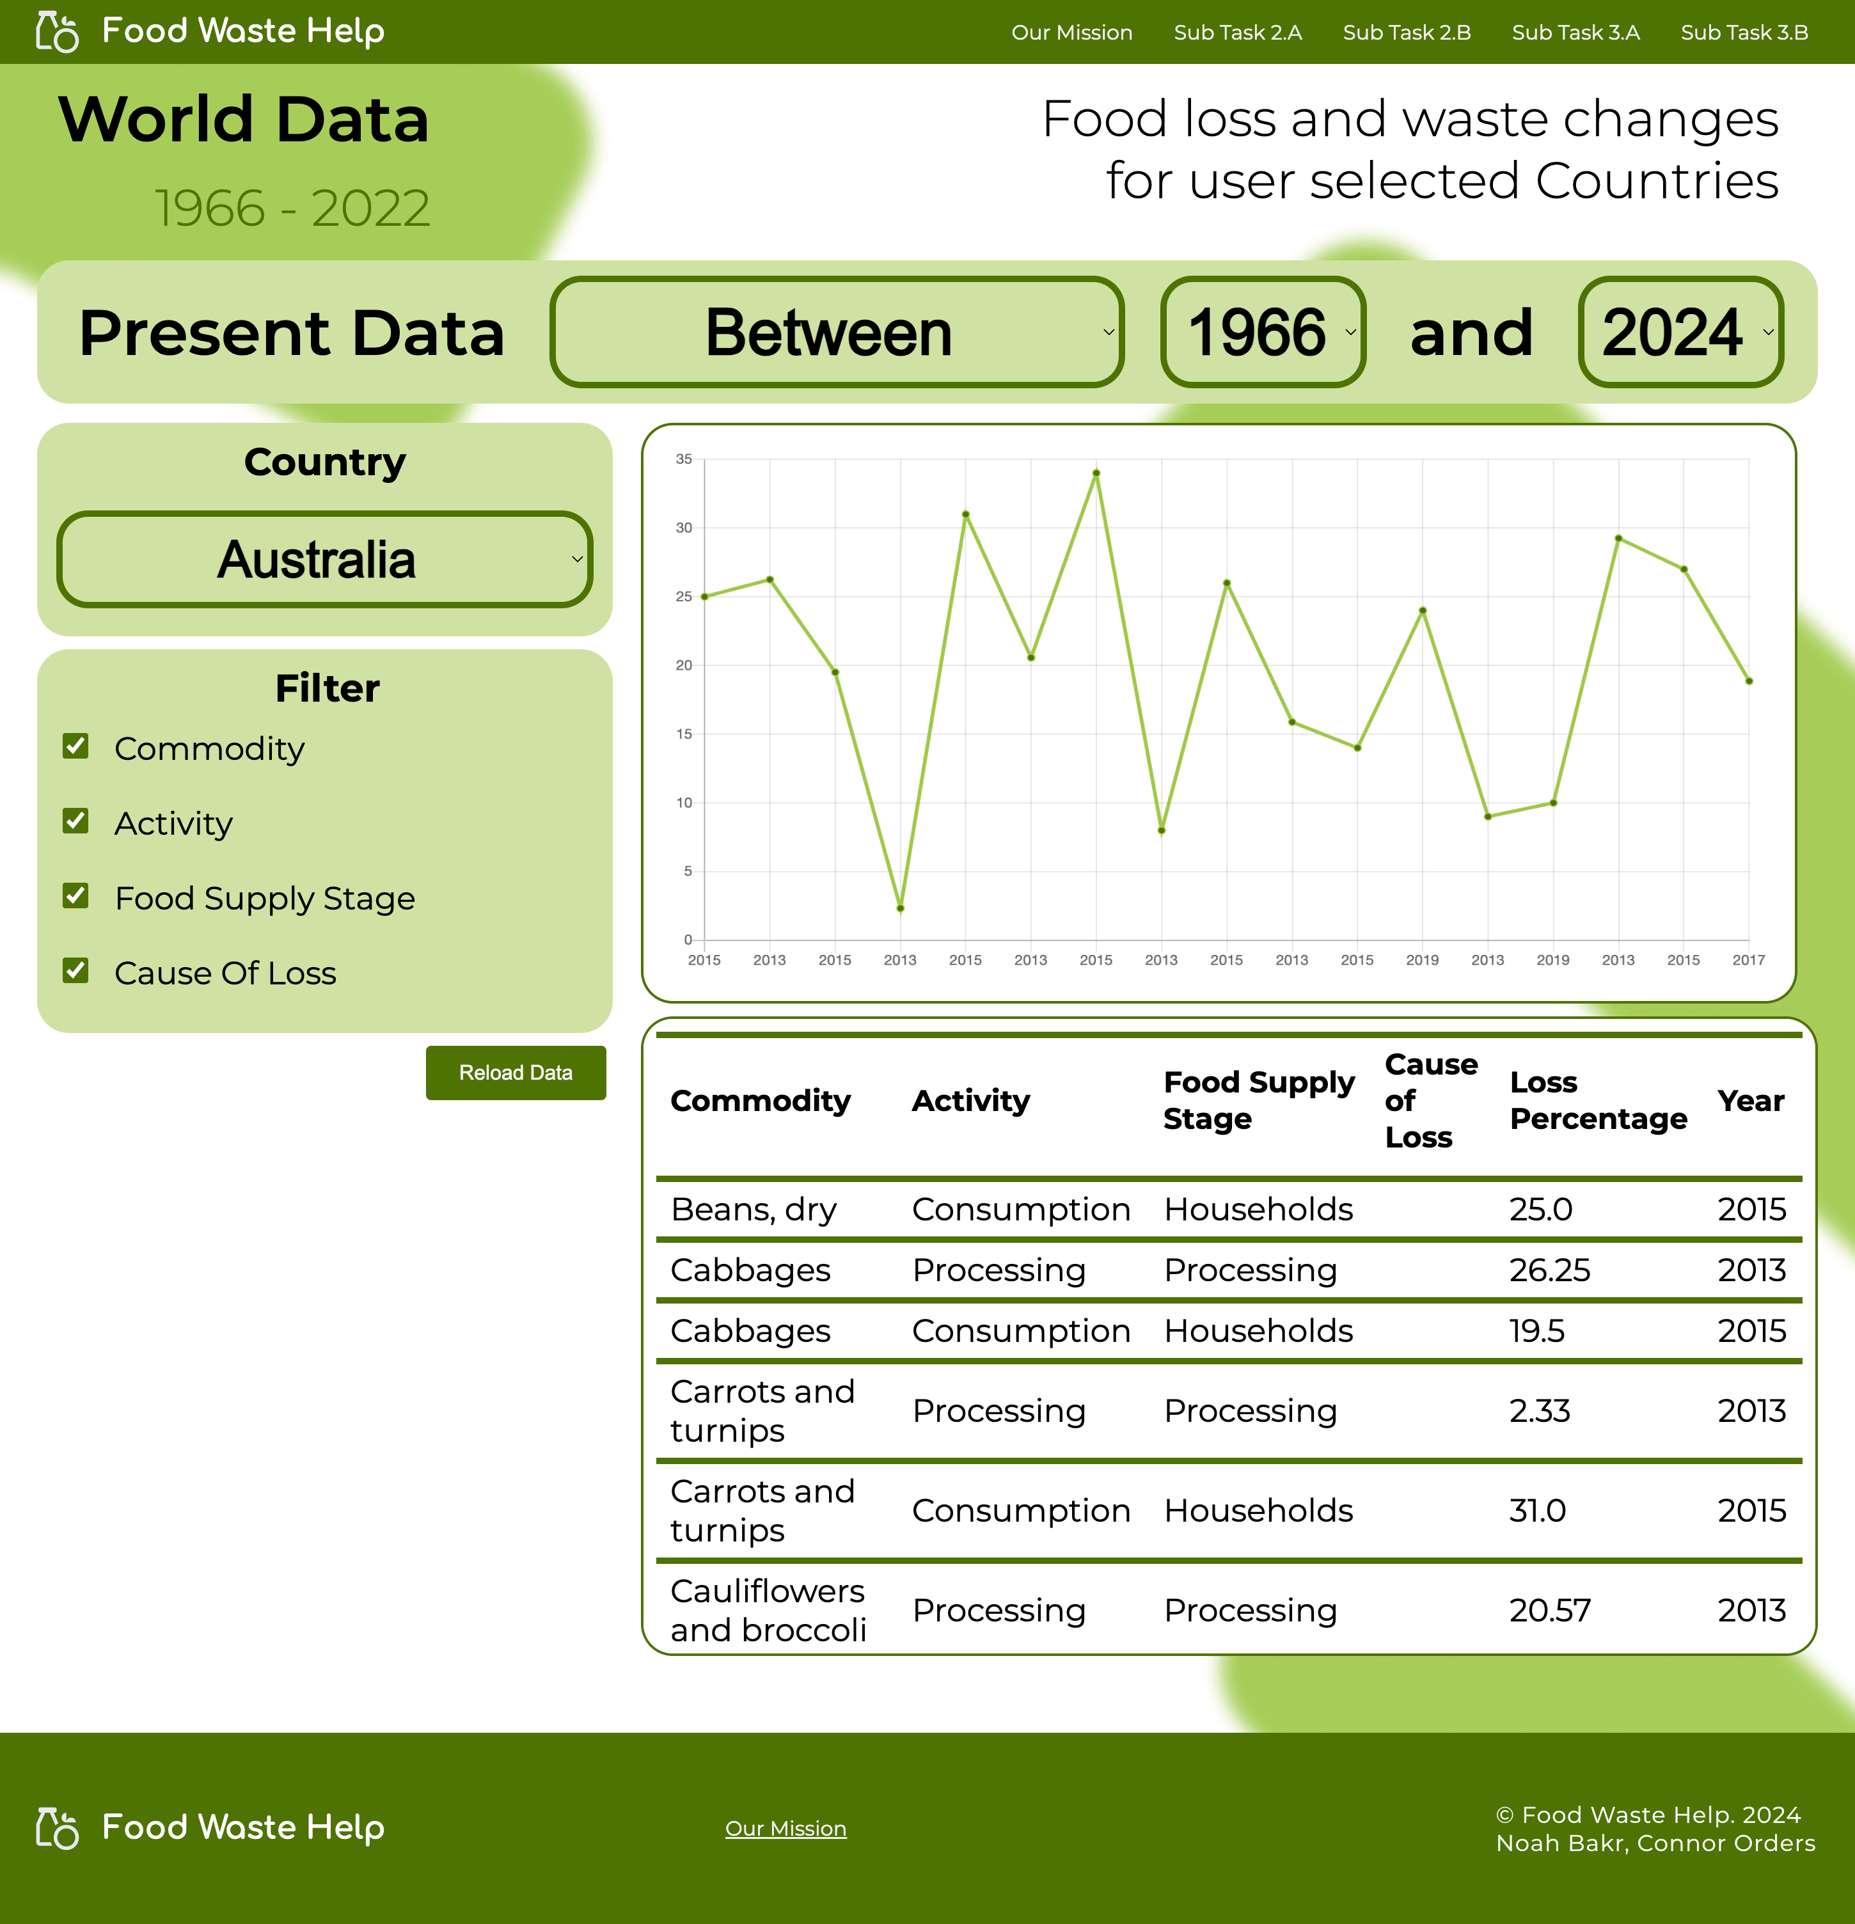
THE FOOD WASTE CHANGES
PAGE
An intuitive UI layout that presents Food Waste Change data based on the user’s input
Notes:
NOAH
Purpose behind this section
Design Patterns
Vertical dropdown menus
Presents data in both a graph and table
Graphs are visual elements for Karen and John
Table shows more information based on

Slide 12
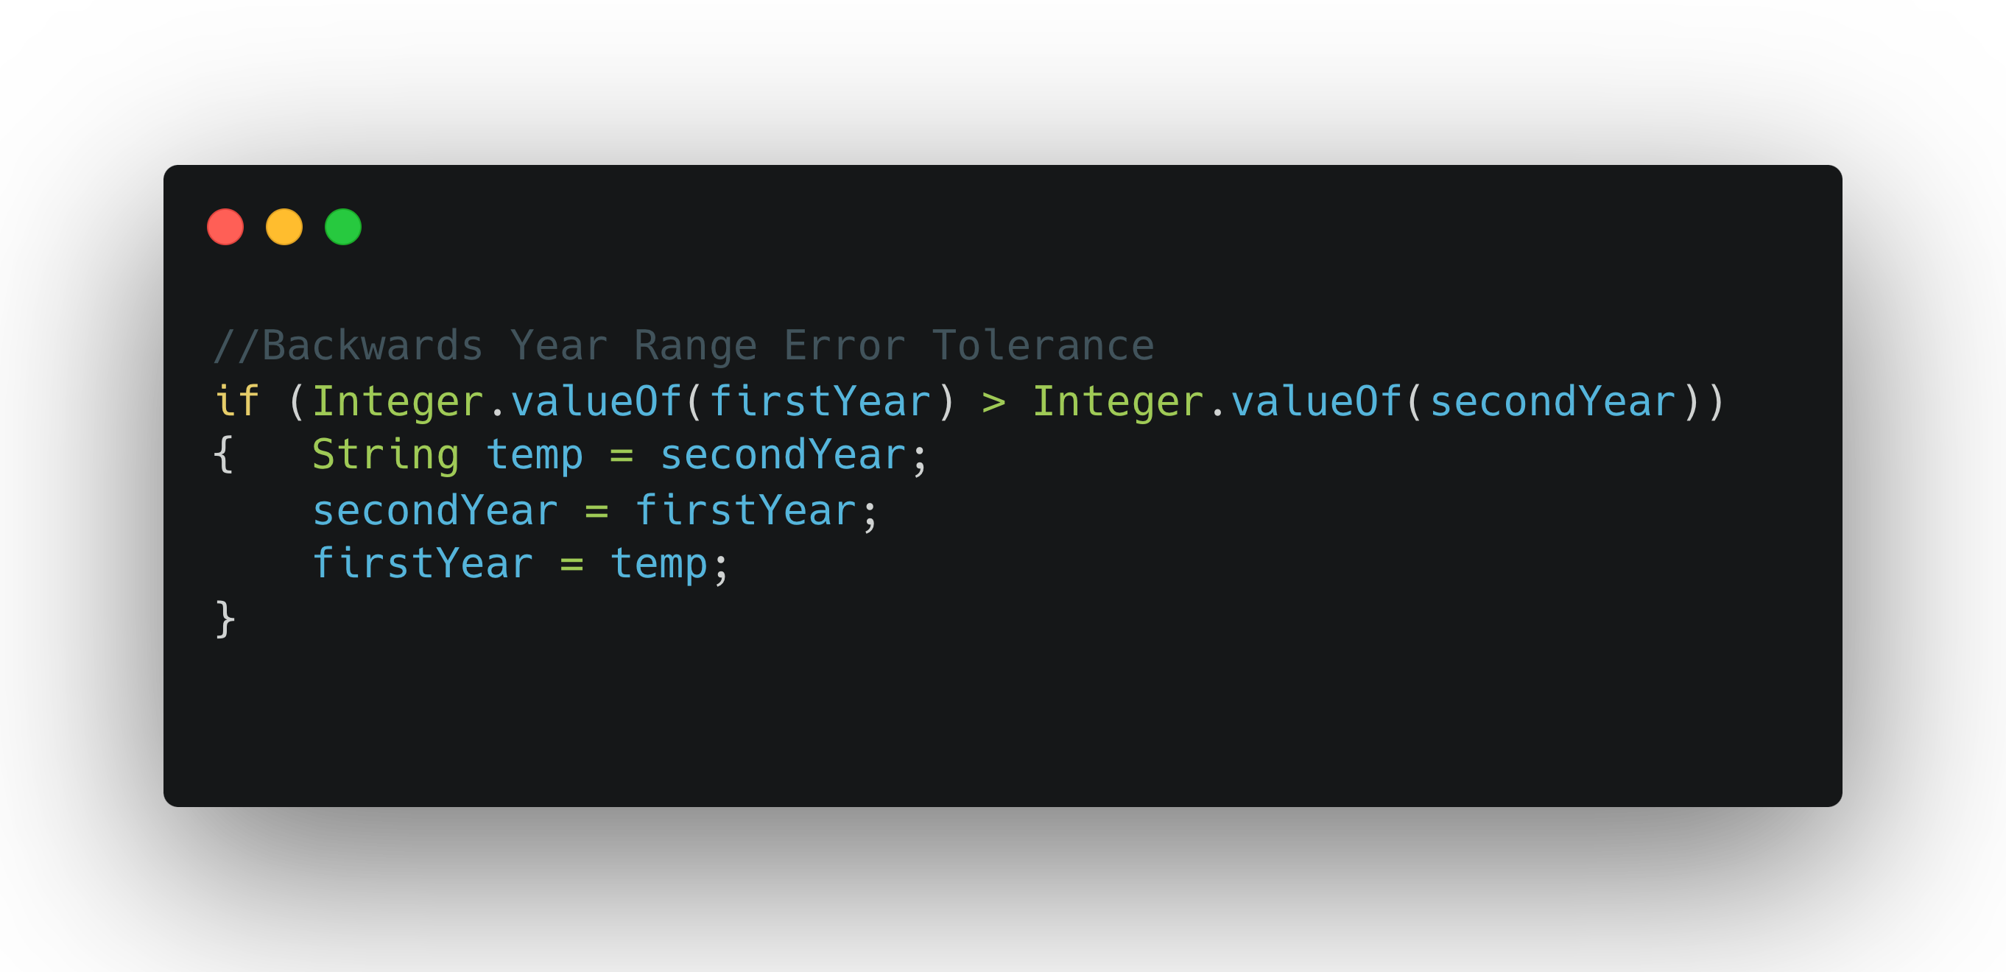
ERROR PREVENTION
DESIGN HEURISTIC
Notes:
NOAH
Simple var swap before query
Users don’t have to worry about the order of their input
A backwards year range may not be something users pick up on
The code acts as if their input is correct by providing their requested query

Slide 13
THE FOOD WASTE CHANGES
PAGE
A further dive into Food Waste Change data based on the user’s checkbox input
Notes:
NOAH
Purpose behind this section
An alternate data view for users like Lucia Romano
Shows data as a list, with categorical info

Slide 14
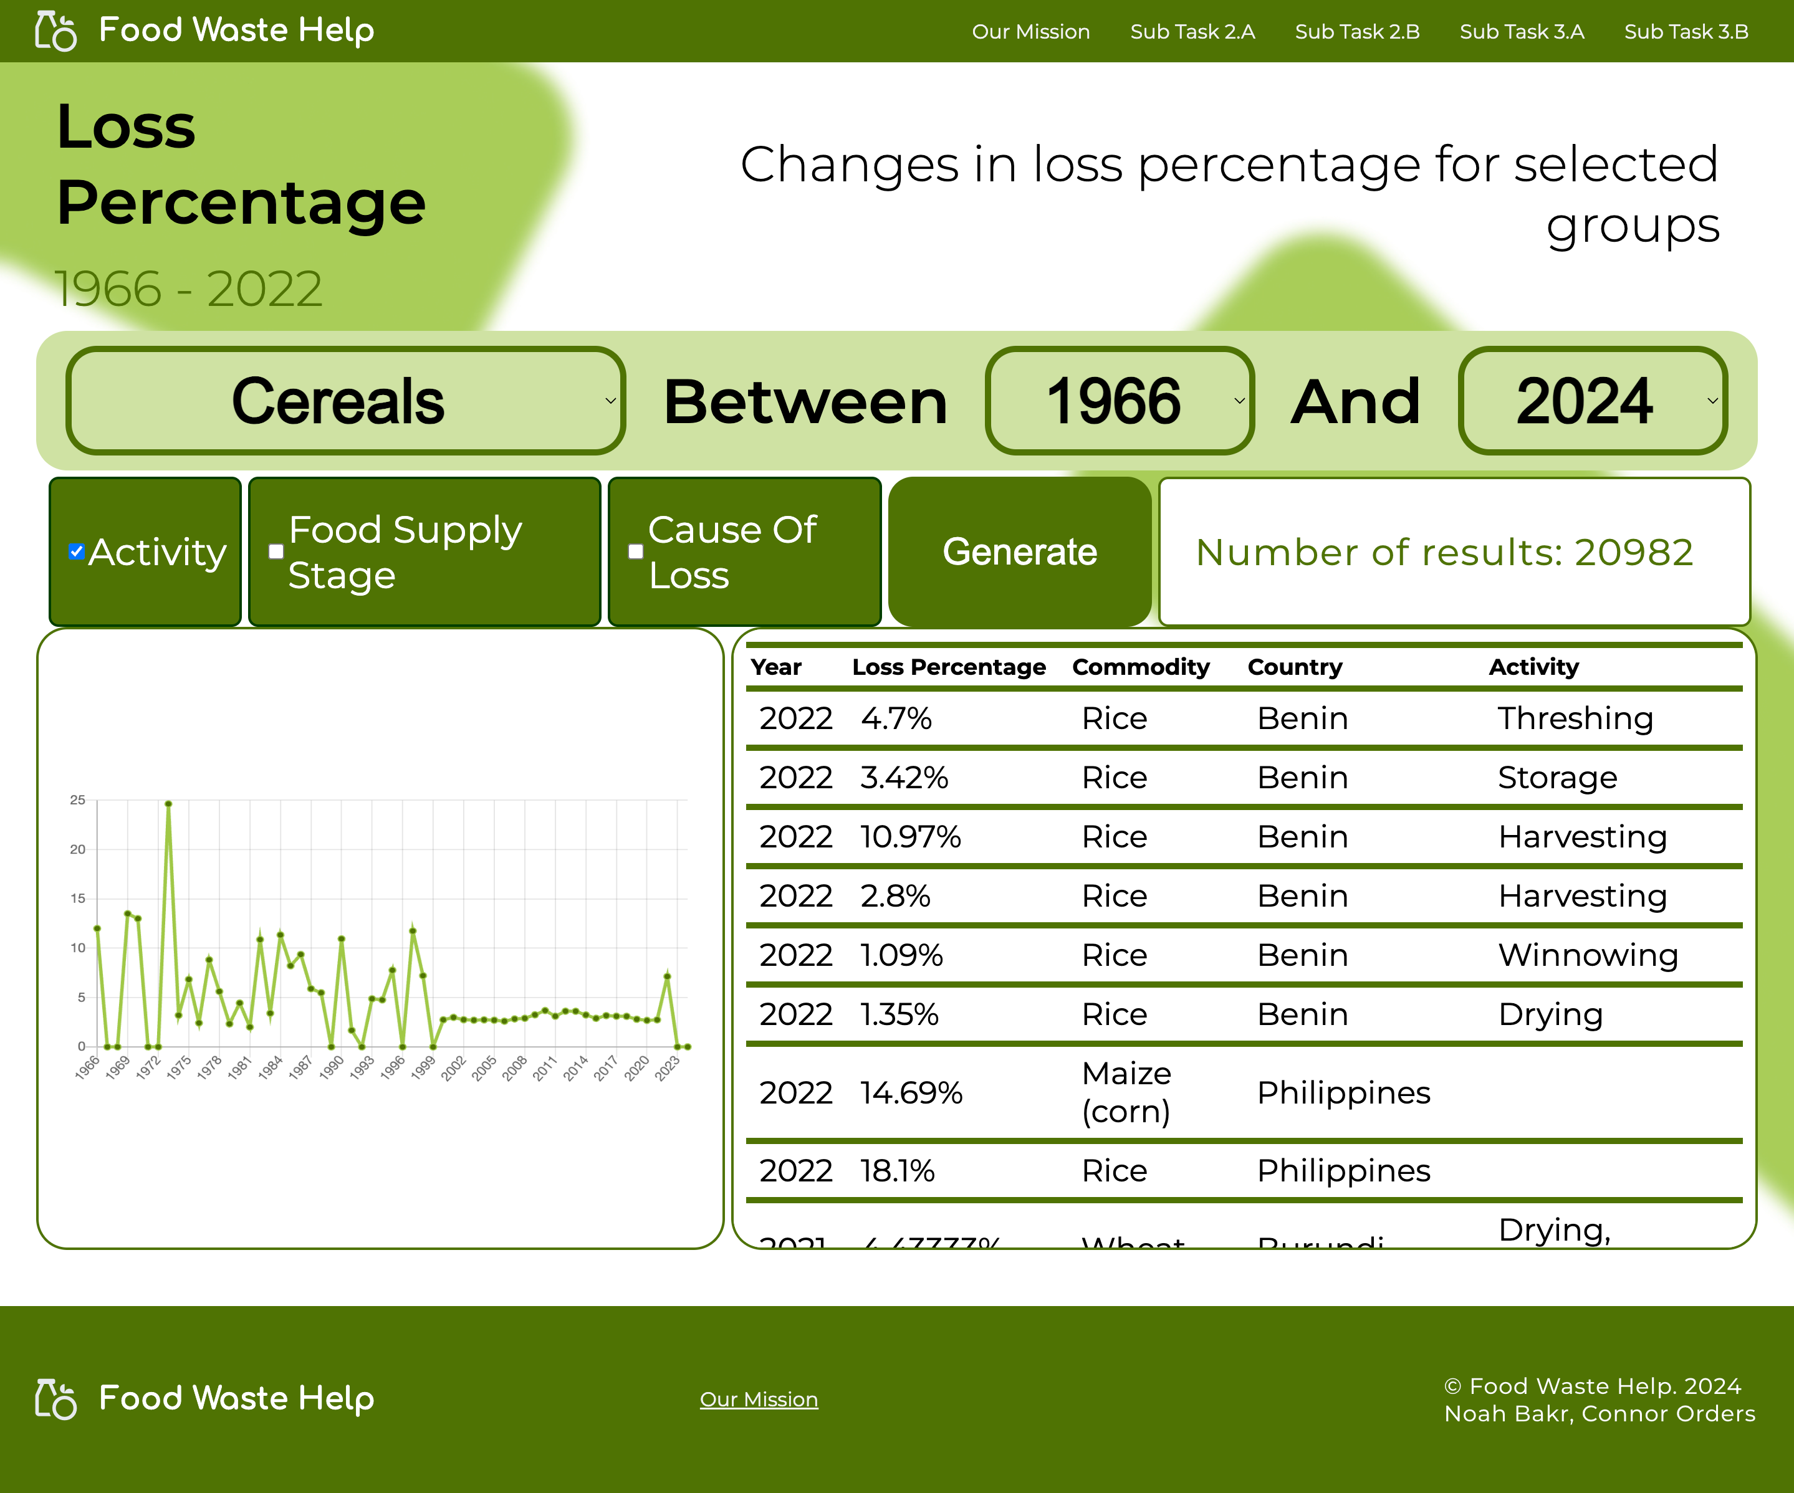
THE PERCENTAGE CHANGES
FOR GROUPS
Users can locate the change in loss percentage filtered by selected commodity groups
Notes:
CONNOR
Purpose behind this section
‘Next slide’ for scroll
Satisfies the needs & goals of the Personas.
Large buttons
Design Patterns
Drop downs
Checkboxes

Slide 15
THE PERCENTAGE CHANGES
FOR GROUPS
Users can locate the change in loss percentage filtered by selected commodity groups
Notes:
CONNOR
Purpose behind this section
‘Next slide’ for scroll
Satisfies the needs & goals of the Personas.
Large buttons
Design Patterns
Drop downs
Checkboxes

Slide 16
VISIBILITY OF SYSTEM STATUS
DESIGN HEURISTIC
Query returns the number of results (records)
Provides user with a sense for the size of database query
Notes:
CONNOR
Presents the number of records
Let's the user know their input was received
Returning 0 records is acknowledged
User control and freedom - Limit loading load more button

Slide 17
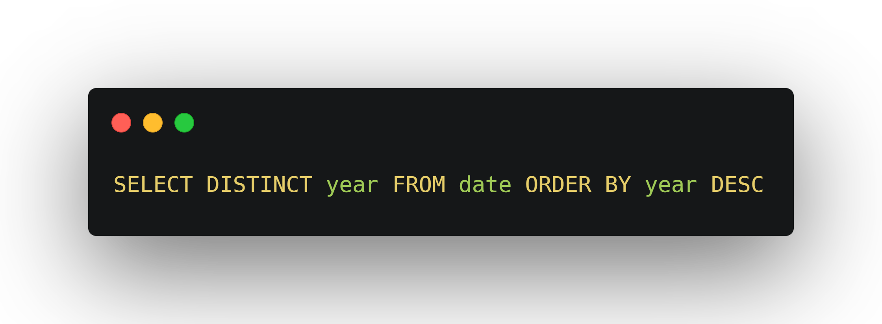
CONSISTENCY AND STANDARDS
Scrolling to the bottom of the years dropdown was annoying to users
Query returns years column in reverse order (2024 to 1966)
Notes:
CONNOR
Users found it annoying to scroll to 2022
Query returns DESC
If we didn't have error prevention this could minimize the chance of users breaking something

Slide 18
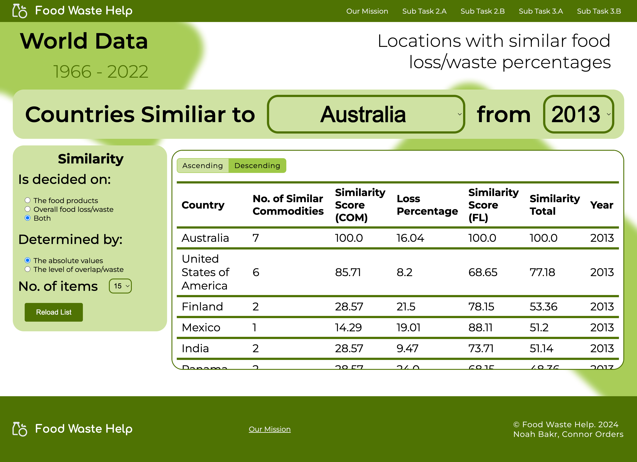
THE SIMILAR COUNTRIESPAGE
A look into the countries with similar data to the user’s choice, through their deciding and determining factors
Notes:
NOAH
Purpose behind this section
Advanced user Lucia can adopt complex queries
Through simple inputs
Help her find those similar countries and hone her research
Design Patterns
Fill in the Blanks
Sort by column
Table filters (determined by)

Slide 19
RECOGNITION RATHER THAN RECALL
DESIGN HEURISTIC
Users enters inputs with predefined choices
Choices are formed in a sentence for better understanding
Notes:
NOAH
Choices are preselected, allowing the user to infer the input’s needs
In the form of a sentence, allows personas like John with low skill to interpret
Choices stay after submitting

Slide 20
THE FOOTER
ELEMENT
Navigation bar is fixed to screen, so the footer is a ‘simple’ version to catch the mouse cursor
Notes:
NOAH
Marks the end of a webpage
Contains logo, mission link and credits
It catches the mouse and provides way to mission, but user should use nav bar

Slide 21
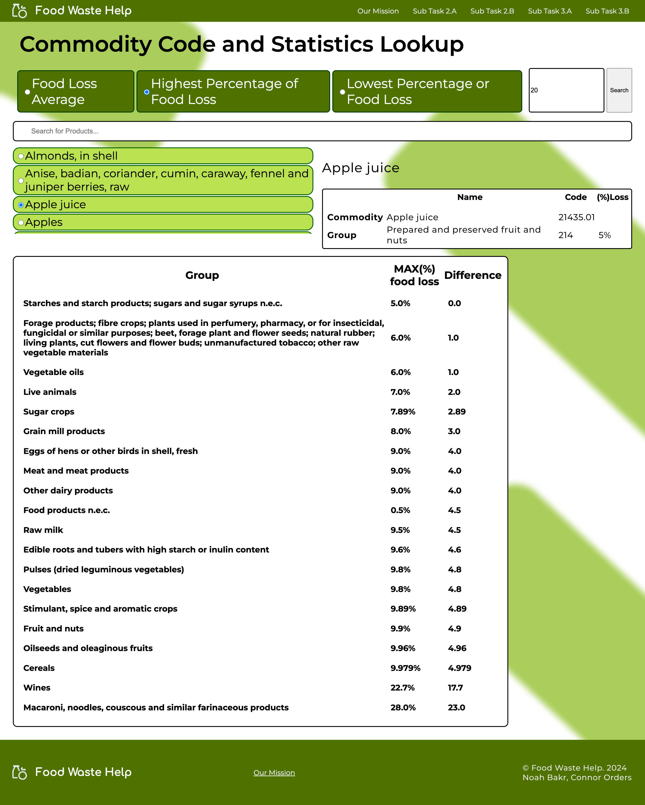
THE COMMODITY LOOKUP
PAGE
Allows users to select a specific commodity and view data for each sub-group
Notes:
CONNOR
Purpose behind this section
‘next slide’ to scroll
Explain how it satisfies the needs & goals of the Personas.
Design Patterns
Autocomplete search bar

Slide 22
THE COMMODITY LOOKUP
PAGE
Allows users to select a specific commodity and view data for each sub-group
Notes:
CONNOR
Purpose behind this section
Explain how it satisfies the needs & goals of the Personas.
Design Patterns
Autocomplete search bar

Slide 23
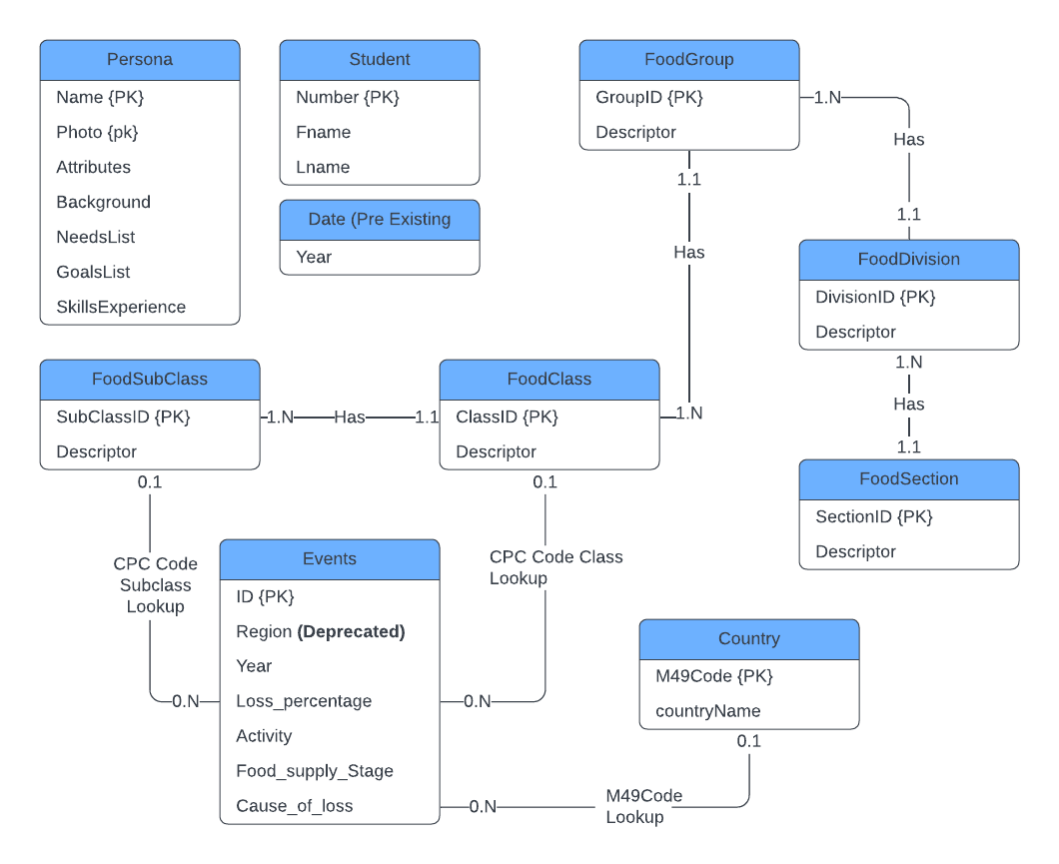
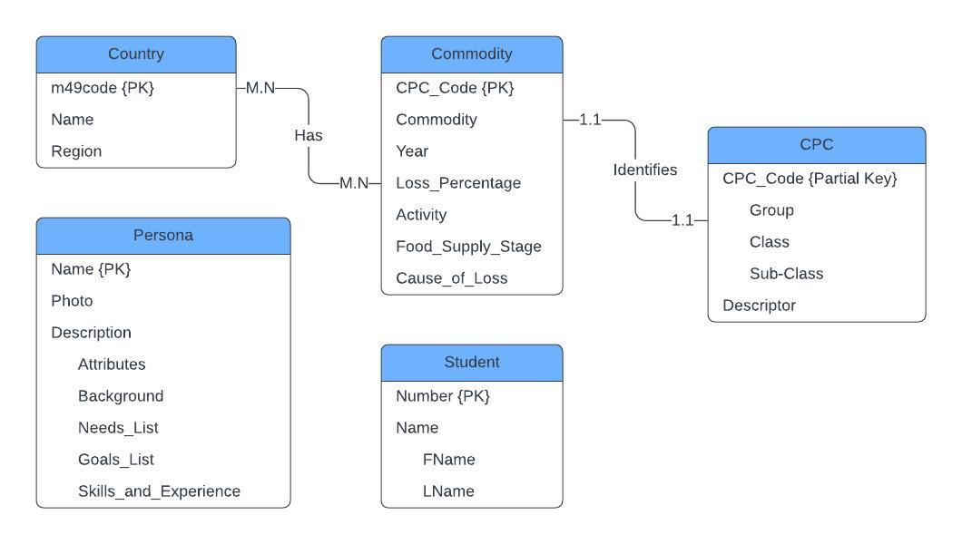
ER DIAGRAM DEVELOPMENT
Milestone 1 ER diagram
Milestone 3 ER diagram (final)
Notes:
CONNOR
Speak about the necessary ER diagram changes

Slide 24
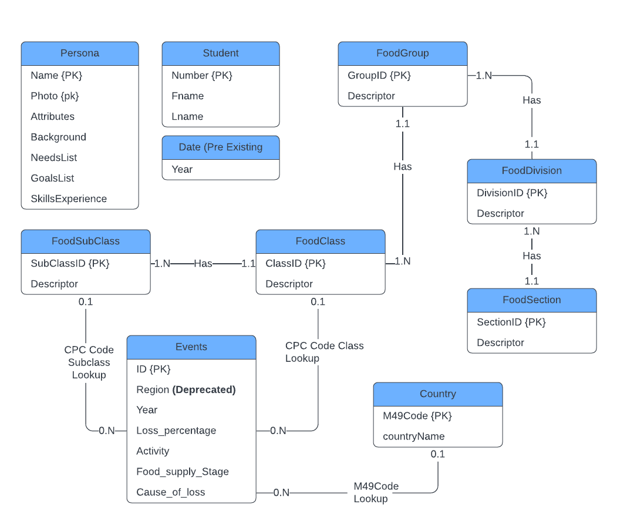
DEPENDENCIES.
Student Number -> First Name, Last Name
Persona Name, Photo -> Attribute, Background Name, NeedsList, GoalsList, SkillsExperience
SectionID -> FoodSection.Descriptor
DivisionId -> FoodDivision.SectionId, FoodDivision.Descriptor
GroupId -> FoodGroup.DivisionId GroupId, FoodGroup.Descriptor
ClassId -> FoodClass.GroupId, FoodClass. Descriptor
SubclassId -> FoodSubclass.ClassId, Subclass.Descriptor
M49Code -> countryName
ID -> Events.M49Code, Events.Region, Events.Cpc_Code, Events.Year, Events.Loss_Percentage, Events.Activity, Events.Food_Supply_Stage, Events.Cause_Of_Loss
Notes:
CONNOR
Present how your implemented database:
Follows principles of ER modelling.
Enables the database to be queried using suitable SQL queries.
Note dependencies that brings us to 3NF

Slide 25
THIRD NORMAL FORM
<p> Country (m49Code, countryName) Date (Year) Events (ID, M49Code*, Region, Cpc_code*, Year*, Loss_percentage, Activity, Food_supply_stage, Cause_of_loss)
FoodSection (SectionId, Descriptor) FoodDivision (DivisionId, SectionId*, Descriptor) FoodGroup (GroupId, DivisionId*, Descriptor) FoodClass (ClassId, GroupId*, Descriptor) FoodSubclass (SubclassId, ClassId*, Descriptor)
Persona (Name, Photo, Attributes, Background, NeedsList, GoalsList, SkillsExperience) Student (Number, FName, LName) </p>
Notes:
CONNOR
“Present your proposed Database Schema has been normalised into 3NF.”

Slide 26
USABILITY TESTING CHANGES
Notes:
NOAH
Introduce the testing stage

Slide 27
LET’S REVIEW SOME FEEDBACK.
Level One | A
Level Two | A
Level Three | A
Minimalistic Aesthetic
Good colour scheme
Buttons made sense
Businesses text is too small
Charts look good
Country radio buttons were clunky
Default values are not updated
Intuitive radio buttons
Level One | B
Level Two | B
Level Three | B
Large chunks of text
Background hurt readability
Inefficient scrolling
Year dropdowns with reversed order
Should be able to select multiple choices
User’s choice is lost in scroll element
Notes:
NOAH
Present an overview of feedback – let viewers read this
Good
Minimalistic aesthetic
Colour scheme
Bad
Large chunks of text
Background was an issue
Default values were not updated

Slide 28
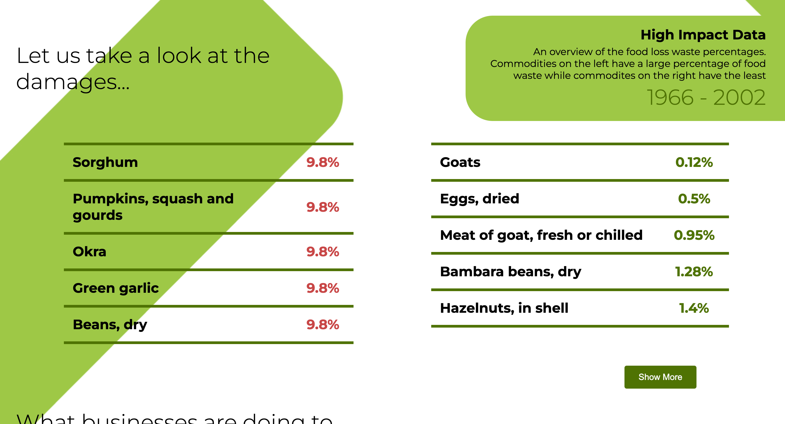
LANDING PAGE CHANGES
Background made it difficult to read
Added a blur layer to background
Lightened the green colour
Notes:
NOAH
Users found reading text difficult to read
Borders affected this (harsh)
Blur layer was added to the background image
Green’s alpha value was changed to make a lighter green

Slide 29
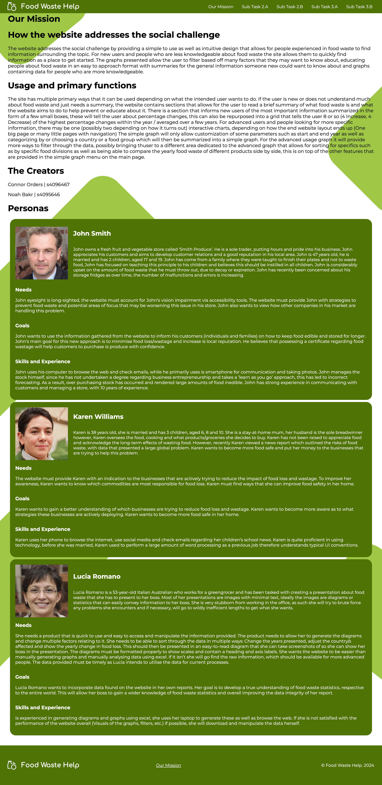
MISSION PAGE CHANGES
Large chunks of text
Background hurt readability
Inefficient scrolling
Notes:
CONNOR
Users experienced a large amount of scrolling to each persona
Was the longest webpage we had
Carousel was added with slides for each persona
Users see how many personas there are from indicator

Slide 30
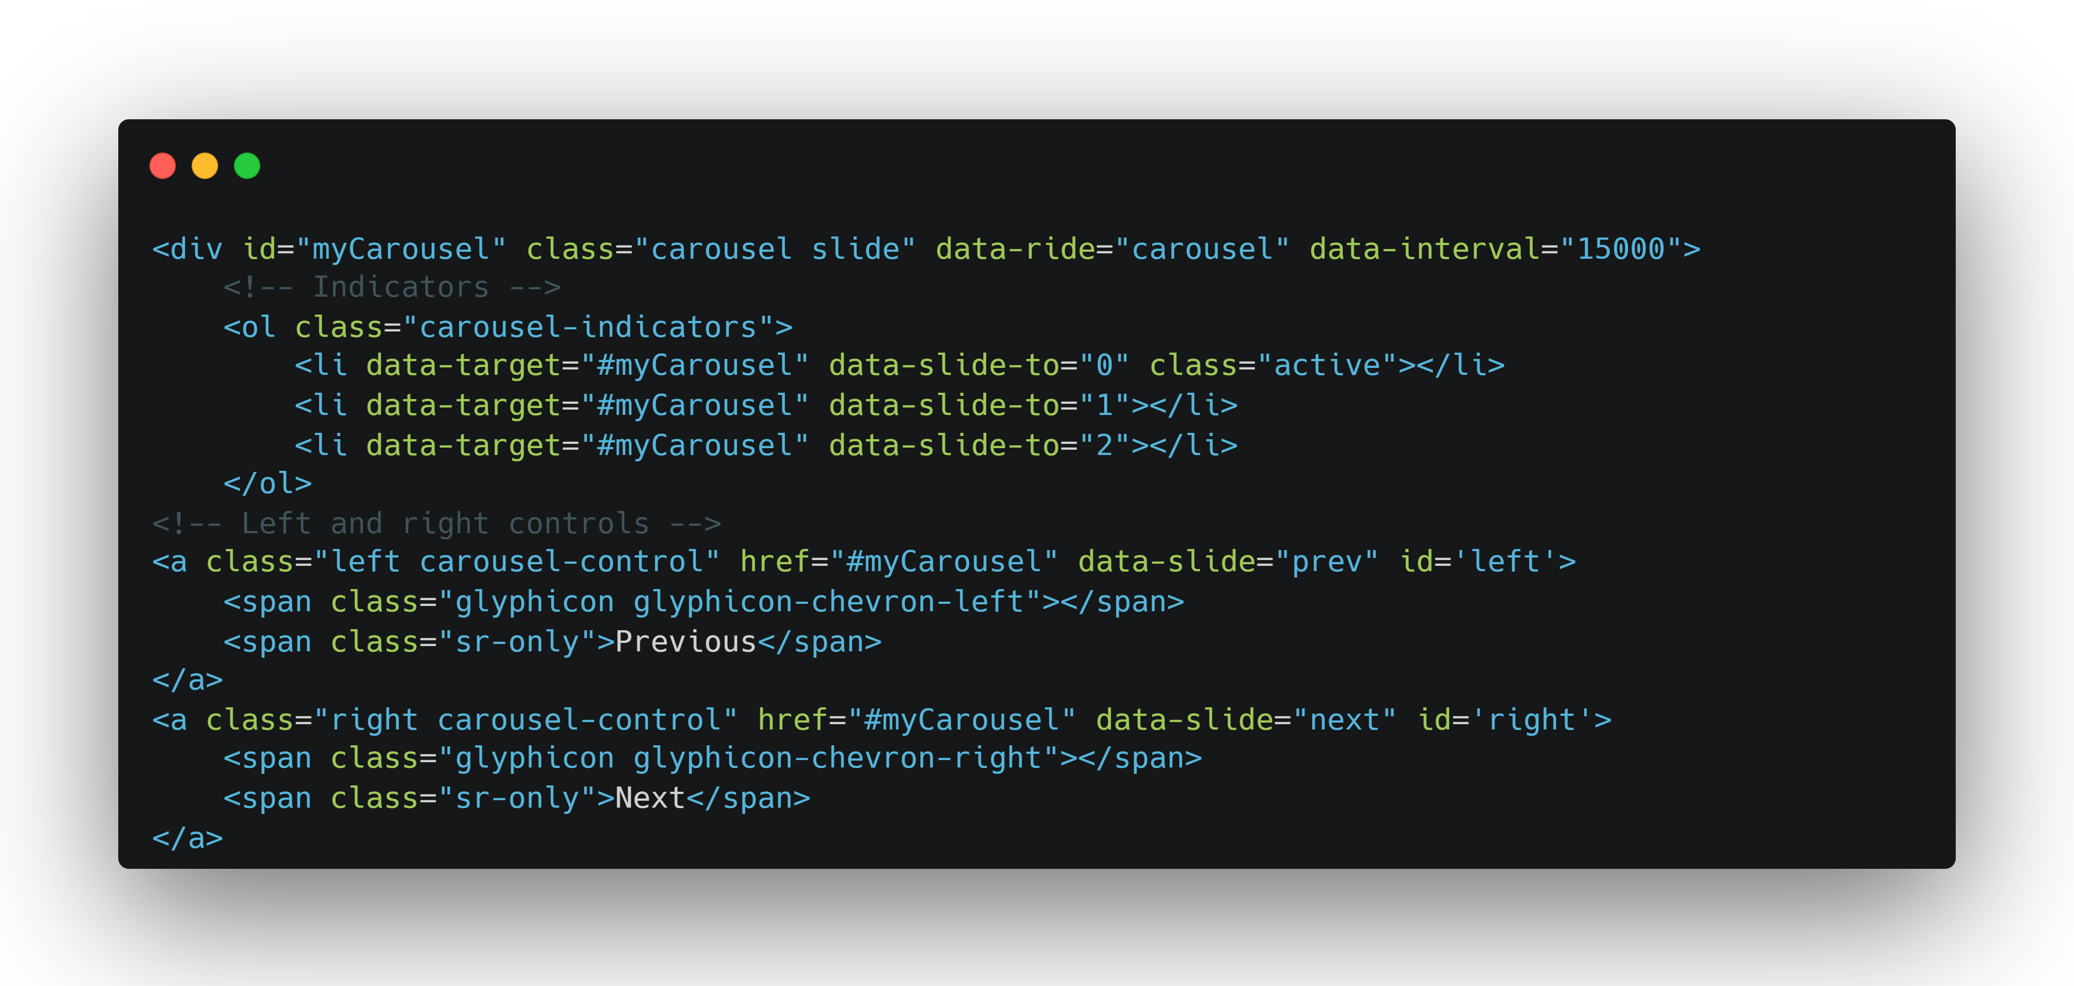
MISSION PAGE CHANGES
Large chunks of text
Background hurt readability
Inefficient scrolling
Notes:
NOAH
First part controls the indicator UI and makes sure it updates
Persona HTML are encapsulated in a carousel wrapper and pulled from database
Second part controls the left/right arrows

Slide 31
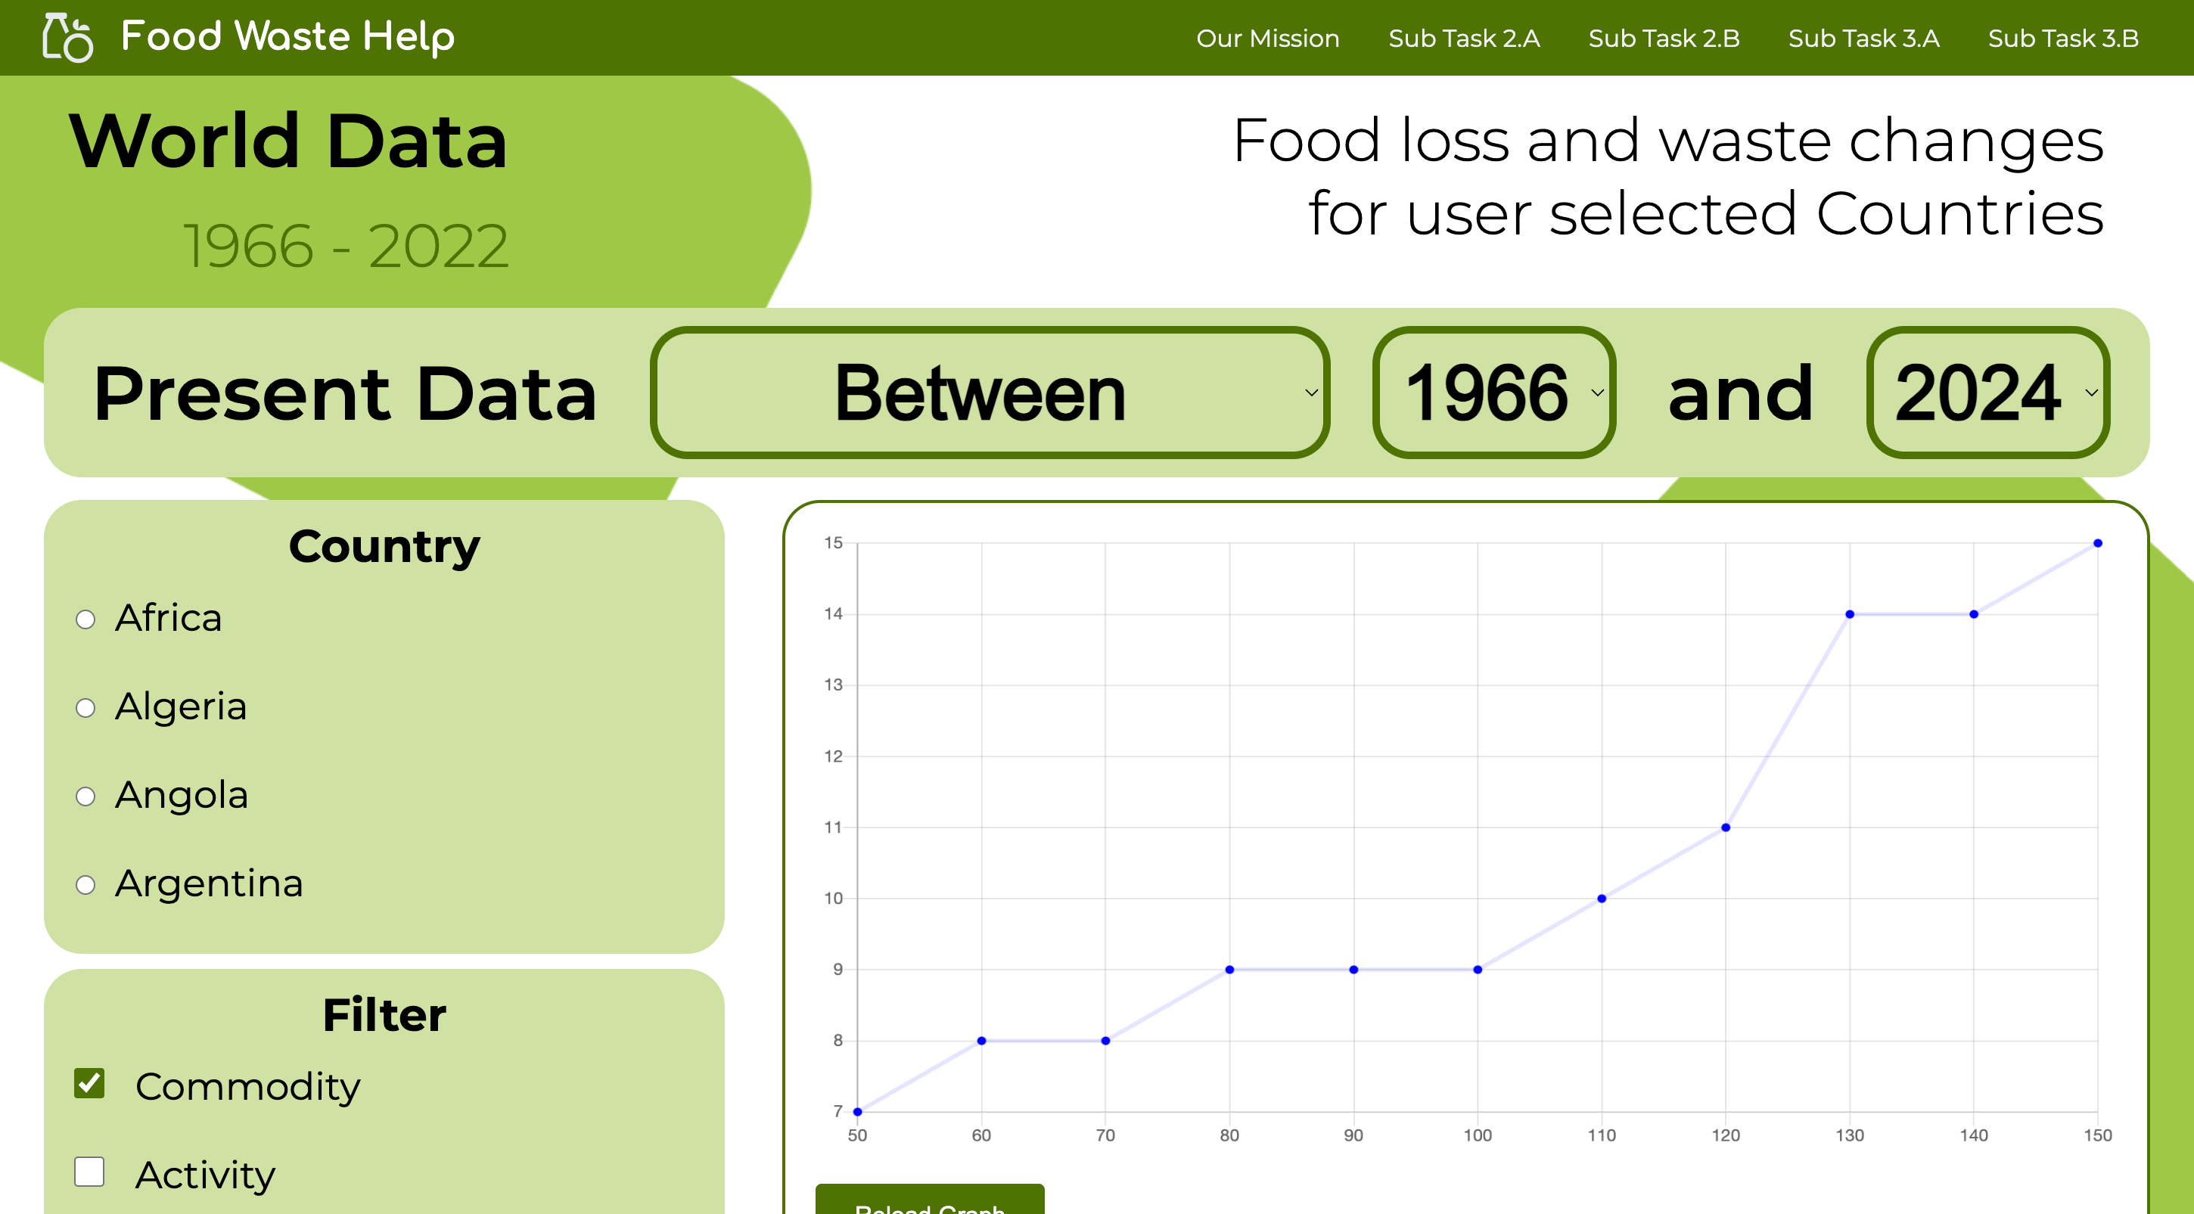
FOOD WASTE CHANGES
Country radio buttons were clunky
Default values are not updated
Country selection is a dropdown
Inputs parse through ‘submit’
Notes:
NOAH
Users found that their Country choice got lost in the scroll
Made users ‘recall’ their choice
Dropdown highlights the user’s choice
Takes up less vertical space

Slide 32
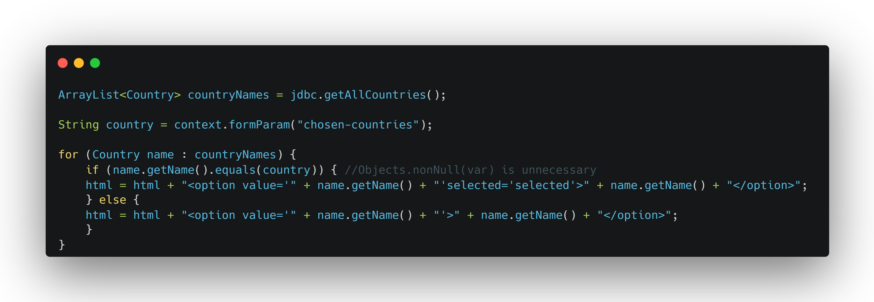
FOOD WASTE CHANGES
Country radio buttons were clunky
Default values are not updated
Country selection is a dropdown
Inputs parse through ‘submit’
Notes:
NOAH
Simple ‘if (the countryName == form parameter var) {select it}
If null, then nothing will match…
Dropdowns do not need Objects.nonnull(var)

Slide 33
RUN-THOUGH FIRST SCENARIO
01
<p> The scenario one task is to locate the Average Food Loss/Waste percentages from Australia regarding Commodities between 2010 and 2020 with their responsible Activity </p>
Notes:
CONNOR

Slide 34
RUN_THROUGH SECOND SCENARIO
02
<p> The scenario two task is to locate the 10 most similar countries to Australia in 2013 regarding the Absolute Values of each country’s Food Loss/Waste Percentages </p>
Notes:
NOAH

Slide 35
THANK YOU!
Noah Bakr
Connor Orders
foodwastehelp.org
Do you have any questions?

Slide 36
CREDITS.
Presentation Template: SlidesMania
Fonts used in this presentation: Roboto Mono and Roboto Bold

